Slide 1
Introduction to RNN
Po-Sen Huang

Slide 2
Outline
RNN basic
RNN
LSTM, GRU
Applications
Sentiment analysis
Language model
Sequence tagging
Machine translation, conversation model
Reference

Slide 3
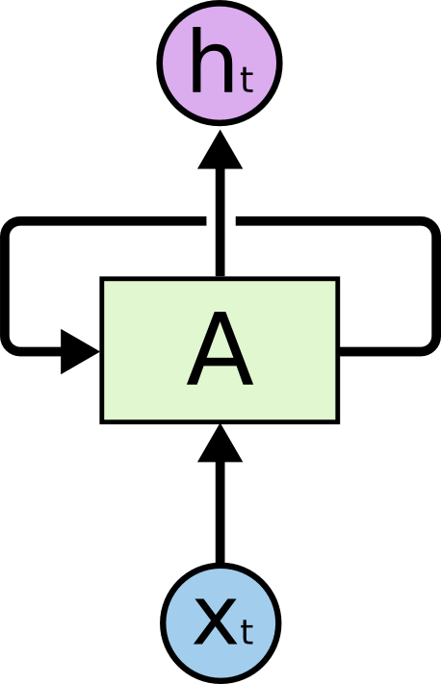
RNN
Output
Input

Slide 4
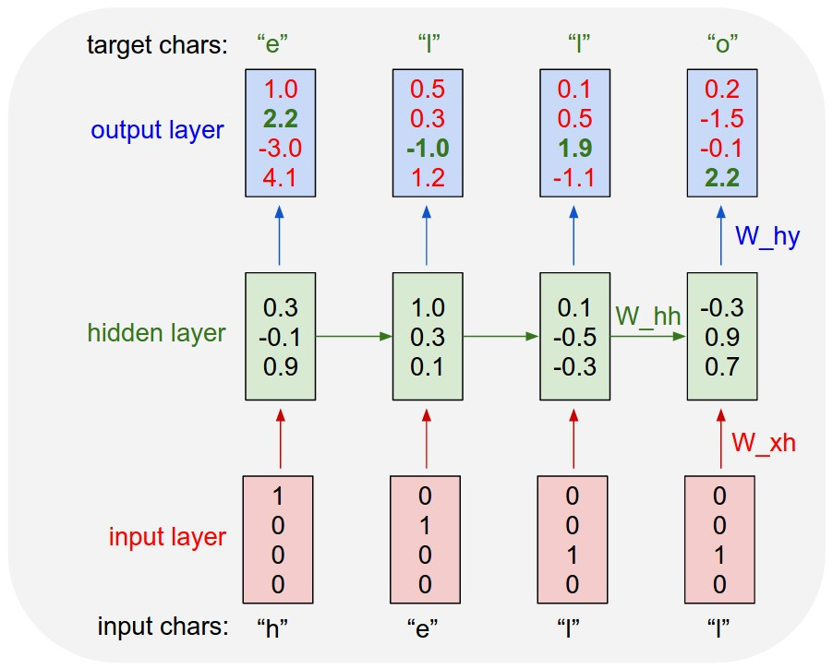
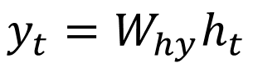
Recurrent Neural Networks
Equation
$$h_{t}=tanh⁡(W_{hh}h_{t−1}+W_{xh}x_{t})$$
$$y_{t}=W_{hy}h_{t}$$
class RNN:
def step(self, x):
self.h = np.tanh(np.dot(self.W_hh, self.h) +
np.dot(self.W_xh, x))
y = np.dot(self.W_hy, self.h)
return y
[Karpathy, Colah]

Slide 5
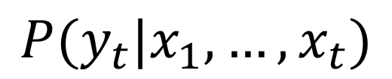
Recurrent Neural Networks
$$P(y_{t}|x_{1},…, x_{t})$$
Applications
[Karpathy, Colah]

Slide 6
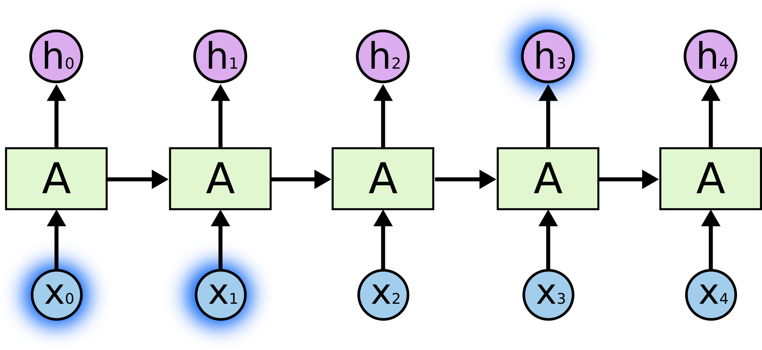
Back-propagation Through Time (BPTT)
Vanishing or exploding gradient problem
E0
E1
E2
E3
E4
[Colah]

Slide 7
Formally - Vanishing or exploding gradient problem

Slide 8
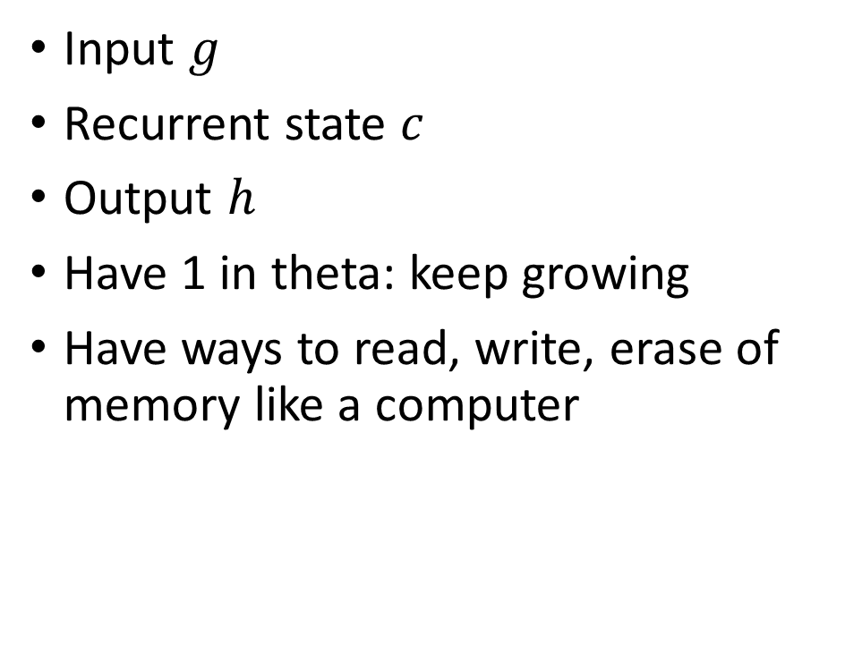
A simple solution
Input $g$
Recurrent state $c$
Output $h$
Have 1 in theta: keep growing
Have ways to read, write, erase of memory like a computer
Notes:
Weights:
activation: identity, gradient 1
https://www.quora.com/How-does-LSTM-help-prevent-the-vanishing-and-exploding-gradient-problem-in-a-recurrent-neural-network

Slide 9

LSTM

Slide 10
Long Short Term Memory networks (LSTM)
Gate: Optionally let information through
Cell state: long term memory
Forget gate: determine what old information to forget
Input gate: determine what new information to store
Output gate: decide what to output

Slide 11

Cell State – Long-term memory
[Colah]

Slide 12


Forget Gate, Input Gate
Forget Gate - determine what old information to forget
Input Gate - determine what new information to store
[Colah]

Slide 13

Update Cell State based on Input, Forget Gates
[Colah]

Slide 14

Output Gate - What to Output
[Colah]

Slide 15

Gated Recurrent Unit (GRU)
Merge cell state and hidden state
Combine forget and input gates
[Colah]

Slide 16
Applications

Slide 17

Sequences with RNNs
Output
Hidden
Input
Image Classification
Sentiment Analysis
[A. Karpathy]
Notes:
http://karpathy.github.io/2015/05/21/rnn-effectiveness/

Slide 18
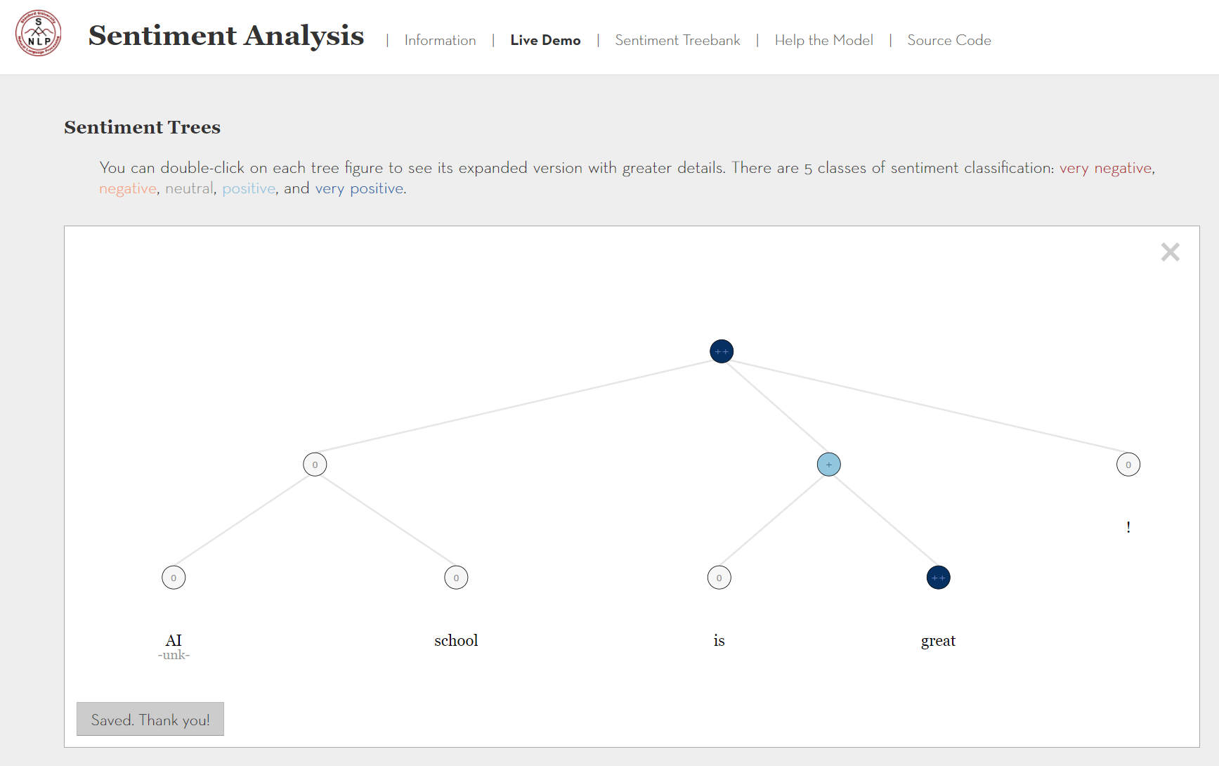
Sentiment Analysis
http://nlp.stanford.edu:8080/sentiment/rntnDemo.html

Slide 19
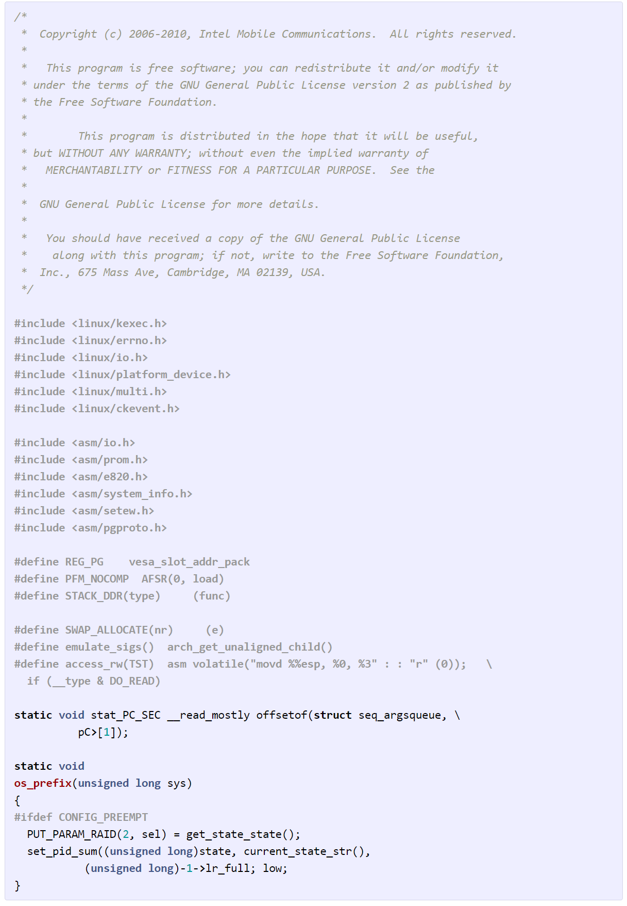
RNN Language Model
[A. Karpathy]

Slide 20
Sequences with RNNs
Output
Hidden
Input
Image Classification
Sentiment Analysis
Sequence Tagging
[A. Karpathy]
Notes:
http://karpathy.github.io/2015/05/21/rnn-effectiveness/

Slide 21
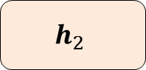
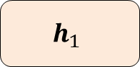
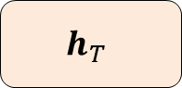
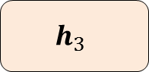
Sequence Tagging
A example in the Airline Travel Information System (ATIS) corpus
 | show | flights | from | boston | to | new | york | today
Slots | O | O | O | B-dept | O | B-arr | I-arr | B-date
O
B-dept
O
B-date
$$h_{1}$$
$$h_{2}$$
$$h_{3}$$
…
$$h_{T}$$
from
Boston
…
today

Slide 22
Sequences to Sequences
Output
Hidden
Input
Image Classification
Sentiment Analysis
Translation
Sequence Tagging
[A. Karpathy]
Notes:
http://karpathy.github.io/2015/05/21/rnn-effectiveness/

Slide 23
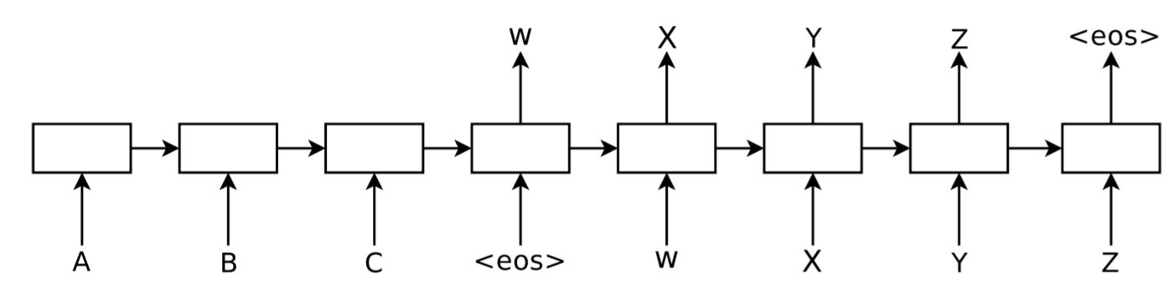
Sequence to Sequence (aka Encoder-Decoder)
Sutskever et al.
Notes:
https://arxiv.org/abs/1409.3215

Slide 24
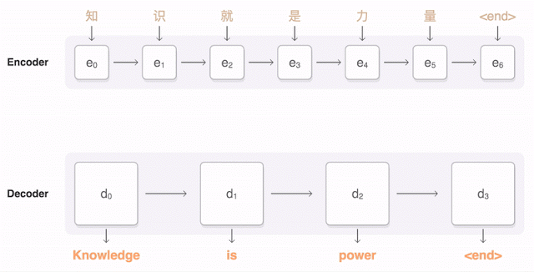
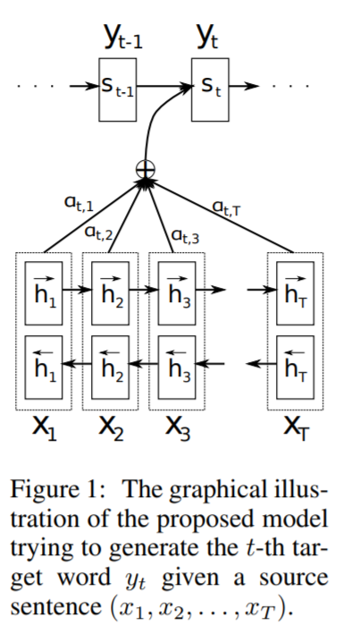
Sequence to Sequence with Attention
[Bahdanau]

Slide 25
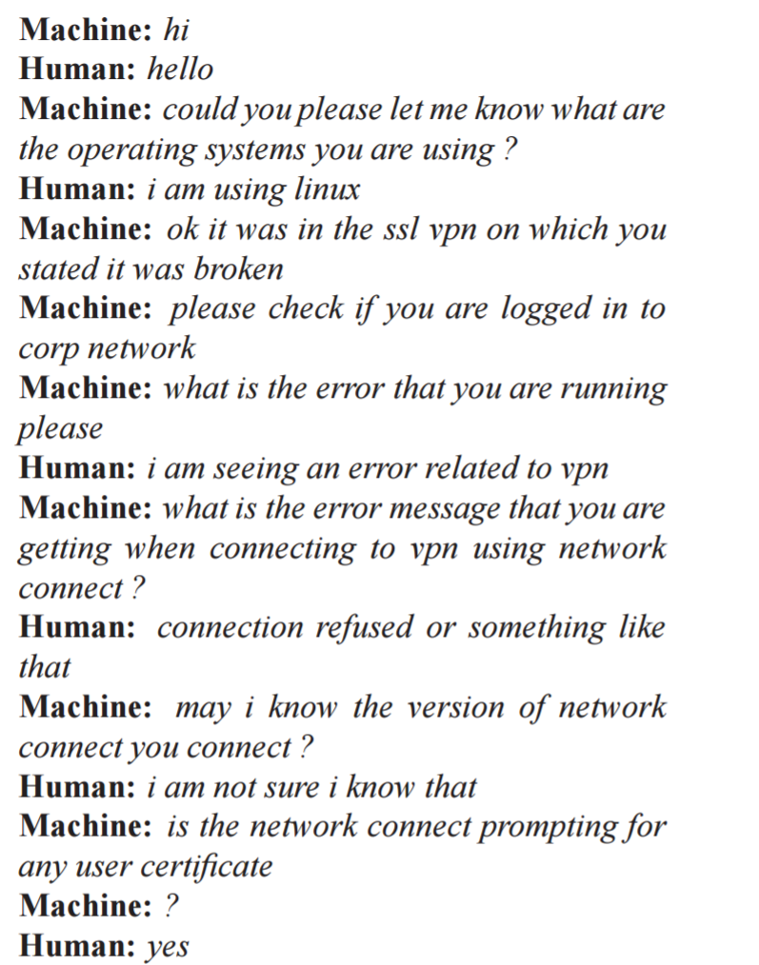
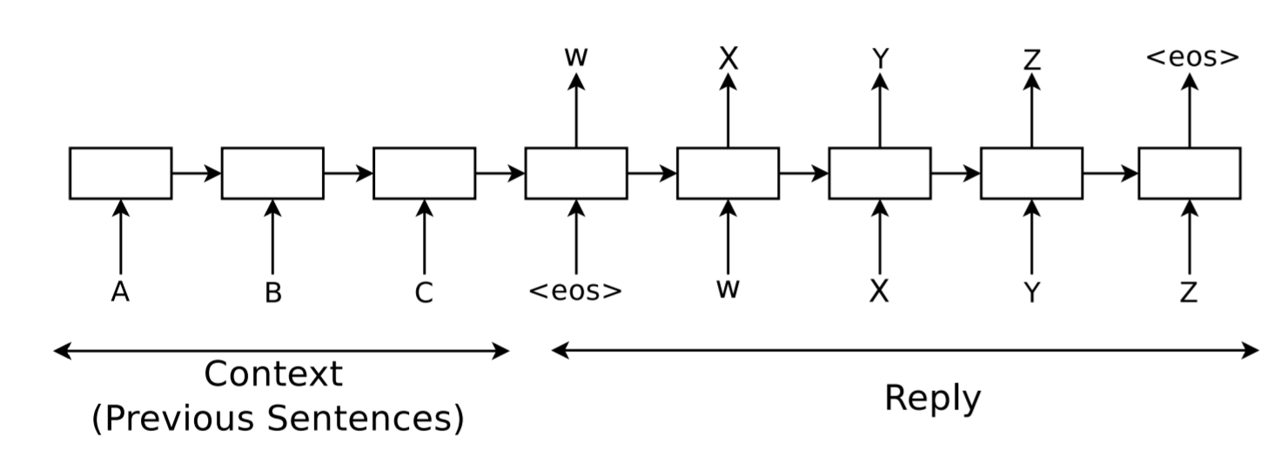
Conversational Model
Notes:
https://arxiv.org/pdf/1506.05869.pdf

Slide 26
Sequences
Output
Hidden
Input
Image Classification
Image Caption
Sentiment Analysis
Translation
Sequence Tagging
[A. Karpathy]
Notes:
http://karpathy.github.io/2015/05/21/rnn-effectiveness/

Slide 27
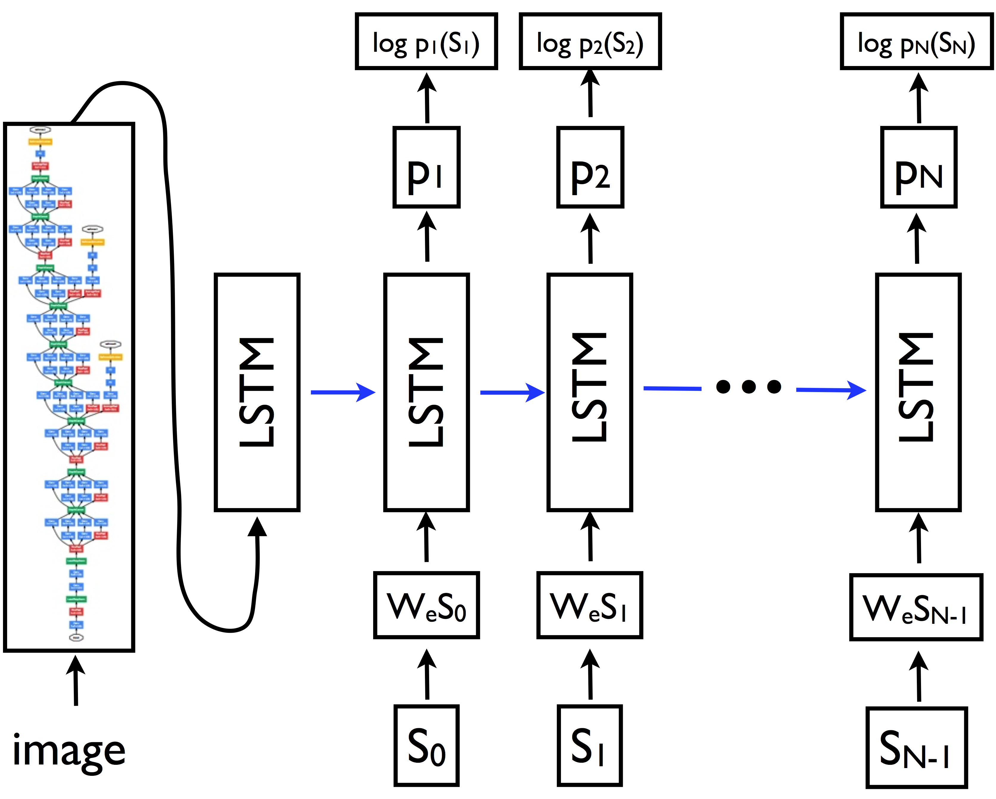

Image Caption
[Vinyals, Xu]
Notes:
https://arxiv.org/abs/1411.4555

Slide 28
Reference
RNN: http://karpathy.github.io/2015/05/21/rnn-effectiveness/
LSTM: http://colah.github.io/posts/2015-08-Understanding-LSTMs/
LSTM: http://deeplearning.cs.cmu.edu/pdfs/Hochreiter97_lstm.pdf
RNN, LSTM: https://www.cs.ox.ac.uk/people/nando.defreitas/machinelearning/lecture11.pdf
GRU: http://arxiv.org/pdf/1406.1078v3.pdf
Sequence to Sequence: https://papers.nips.cc/paper/5346-sequence-to-sequence-learning-with-neural-networks.pdf
Attention: https://arxiv.org/abs/1409.0473

